Slide 1
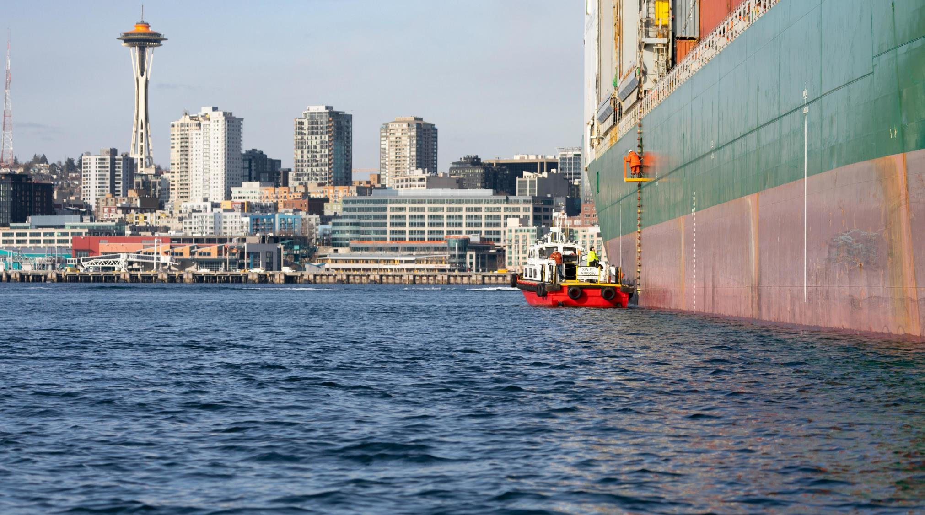
DELIVERING TODAY AND TOMORROW
Maritime Innovation
Port of Seattle Commissioner Hamdi Mohamed | Pacific Maritime Expo | November 9, 2023
Notes:
Thank you Eugene for the introduction.

Slide 2
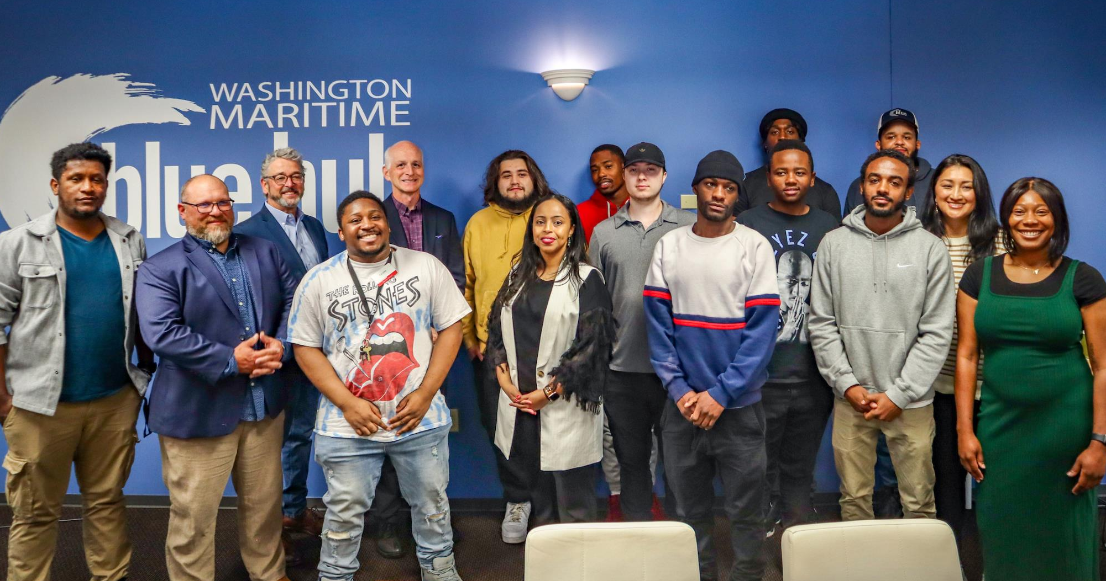
Notes:
Introduce self, why you are happy to be there today
With a mission to create economic opportunity in King County through trade, travel, and commerce I can think of no better place to start my day than with the maritime industry.
Maritime industries have proven for more than a century that you stand at the center of our local economy and can be leaders around the world.
One of the things I enjoy about the Port is highlighting the power of a maritime career.
For example…this picture with Joshua Berger and Congressman Adam Smith and participants at Maritime Blue.
Because the reality is that economic opportunities in maritime are everywhere.

Slide 3
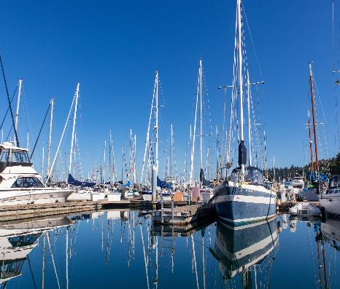
Maritime Lines of Business
Container Cargo
Cruise
Grain and Breakbulk Cargo
Commercial Fishing
Recreational Boating
Industrial Moorage
Notes:
And we’re working to keep it that way!
One of the reasons the Port has been a driver of economic opportunity for more than 100 years is our diversified lines of business.
This is just on the maritime side, never mind adding in the airport.
The value of diversification came into sharp focus during the pandemic, when container cargo surged, and commercial fishing stayed strong, while cruise lost an entire season.
But these businesses are never static. For example, cruise came back stronger than ever before, and in fact, we just ended last week the largest cruise season in our history, serving more than 1.7 million revenue passengers, or 850,000 individual tourists.
We always have new circumstances and challenges, whether they are related to climate change or access to capital or the rising cost of energy...
Two lessons that we truly take to heart based on more than a century of experience, is that maintaining a diversified working waterfront is key to your and our long-term success, and that innovation and development are the fastest way through challenging times.

Slide 4
Capital Improvement Projects: $579M
Maritime and Economic Development Division 2024-2028 by Line of Business
*
*Includes: Elliott Bay Fishing & Commercial and Ship Canal Fishing & Commercial
Notes:
That emphasis on development continues in 2024.
Later this month the Commission will vote on the Port's annual budget and five year capital plan.
You're looking at our plans for the next five years of investing in maritime.
Commercial fishing is the largest category of our capital spending in maritime, which reflects the importance of this industry on the success of the Port, and the regional economy.

Slide 5
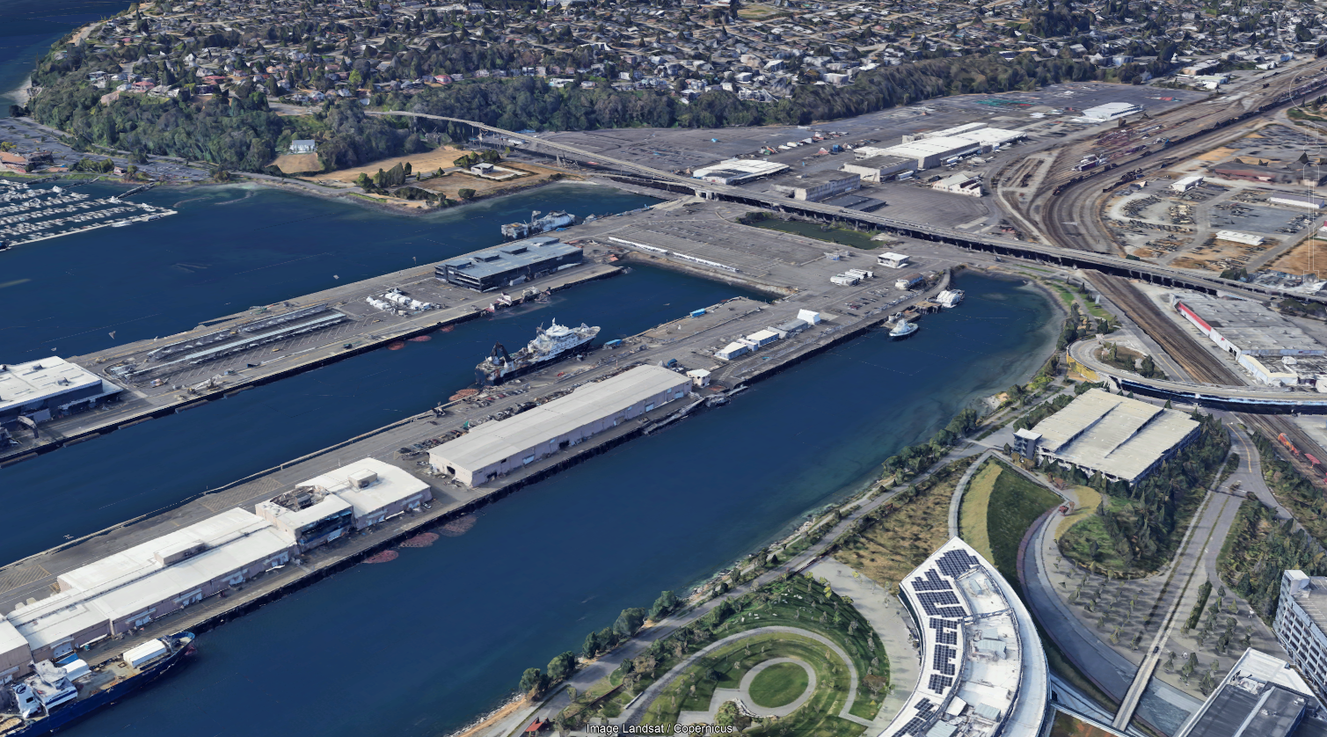
Terminal 91 Berths 6 & 8
Berths 6 & 8
Notes:
Improvements at Terminal 91 make up a major share of our plan.
One example of that commitment is the moorage project underway to upgrade Berths 6 & 8.
The $76 million project returns 800’ of berth space to Pier 90 with moorage designed for fishing and industrial vessels. The environment also benefits since the berths will be equipped with shore power and over 1200 creosote piles will be removed from the area.
Landside, the project includes new consolidated offices for operations, fishing and industry customers.

Slide 6
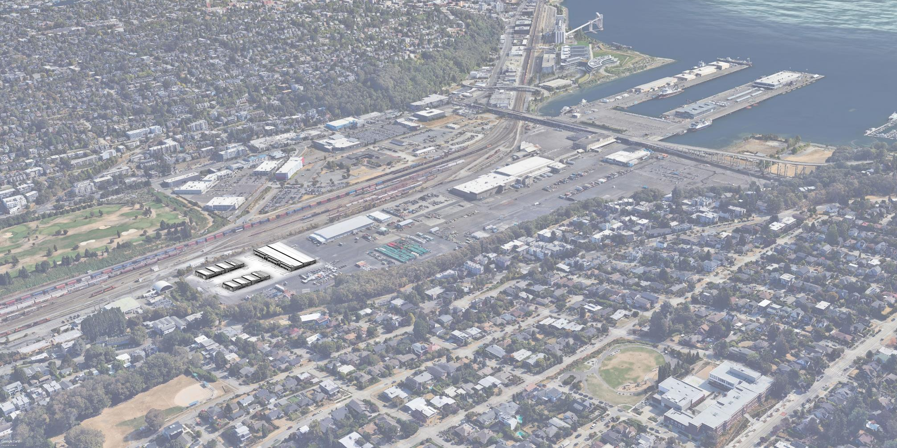
Terminal 91 Uplands
Terminal 91 Uplands Project
Notes:
We envision the docks of Terminal 91 as the starting point for a new Innovation Corridor that reaches north to the Ship Canal.
TheTerminal 91 Uplands project is a major piece of this vision. This two-phase project will help support maritime manufacturers and fishing industry suppliers with 400,000 square feet of flexible, light industrial space.
The first phase will develop the northernmost piece of this property.
Three buildings will house current T-91 tenants and other maritime companies that have expressed an interest in growing their businesses. The second phase would develop an additional 300,000 square feet of light industrial space along with other improvements including extensive utility improvements.

Slide 7
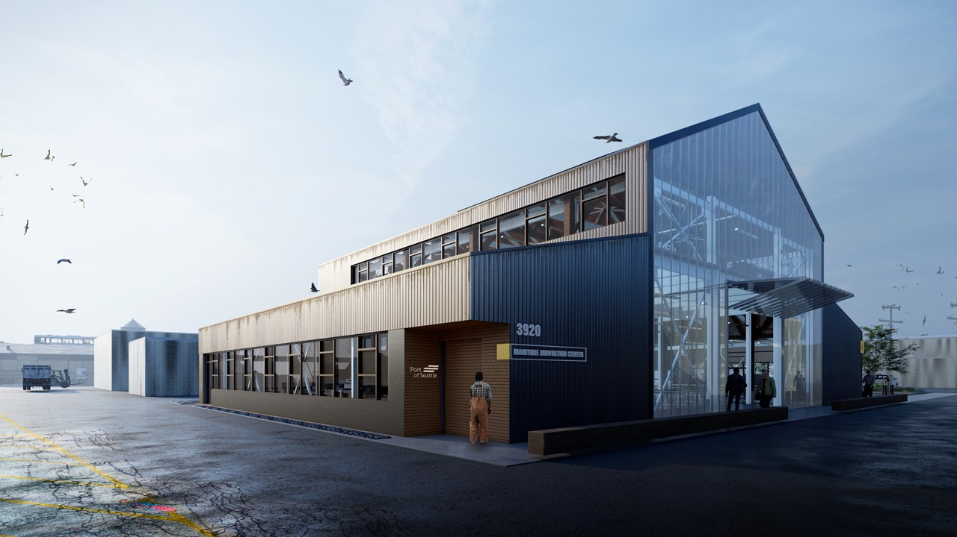
Maritime Innovation Center and Fishermen’s Terminal Redevelopment
Notes:
And of course the Maritime Innovation Center is the heart of this innovation corridor.
We are so excited to finally begin construction on the Maritime Innovation Center (MInC) next year.
This landmark building will be a 15,000 square foot mix of working space for incubators, accelerators, and anchor tenants along with fabrication and event space.
This is where emerging maritime companies can solve industry problems, find technical and financial support, and build their ideas into reality under one roof.
The Port of Seattle will operate the MInC in our great partners, Maritime Blue.

Slide 8
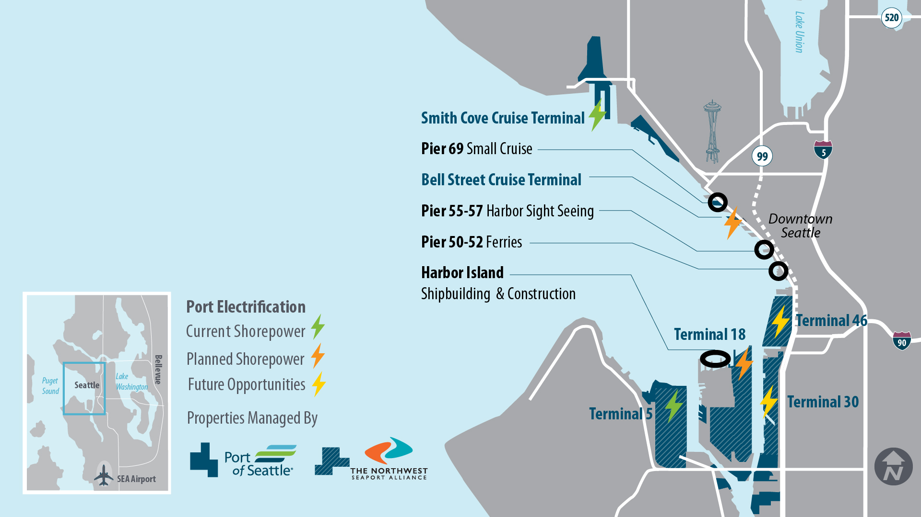
Port Electrification and Seattle Harbor Needs
Notes:
Transitioning Port related industries off of fossil fuels is the greatest innovation challenge of our time.
The Port has adopted electrification as a key strategy for phasing out emissions on the waterfront.
We are working closely with other maritime operators to bring electrification to the entire Seattle waterfront.
Bringing shore power to the Bell Street cruise terminal is underway now. The $32M project is an innovative solution that brings power from Terminal 46 via an underwater submarine cable to provide clean energy to cruise ships. We expect it operational during the 2024 season.

Slide 9
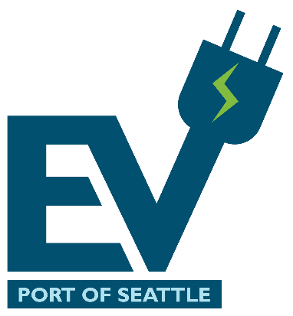
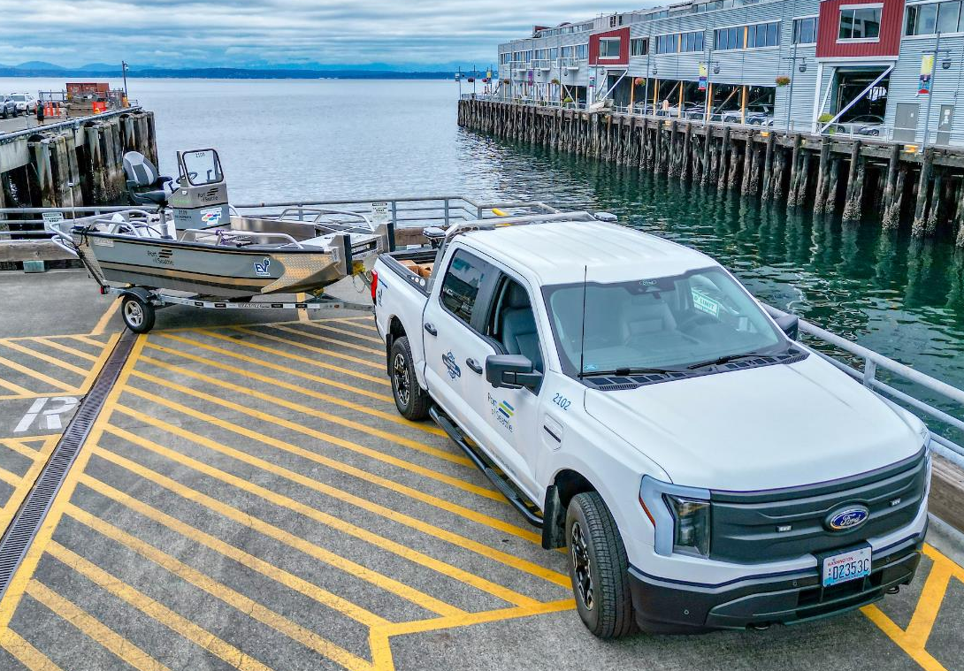
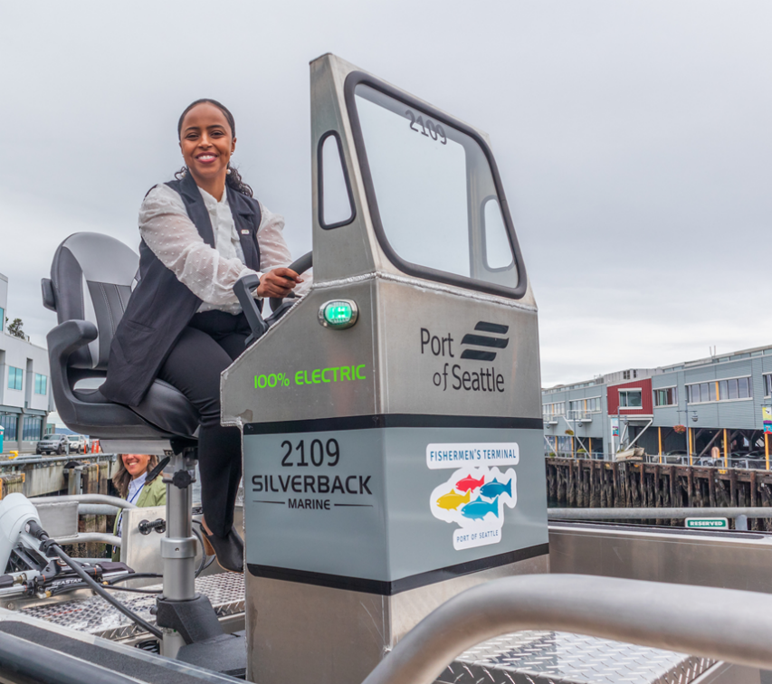
Transition to Electric
Notes:
We are decarbonizing our operations too!
The picture on the right was taken just a few weeks ago at the Port’s headquarters.
Our maritime maintenance team demonstrated their progress on transitioning to an all electric fleet by 2030.
We now have EV cars, vans, a truck, and a workboat. The EV boat comes from Silverback Marine and is powered by Pure Watercraft...
...who, speaking of innovation... were both in the Maritime Blue accelerator.

Slide 10
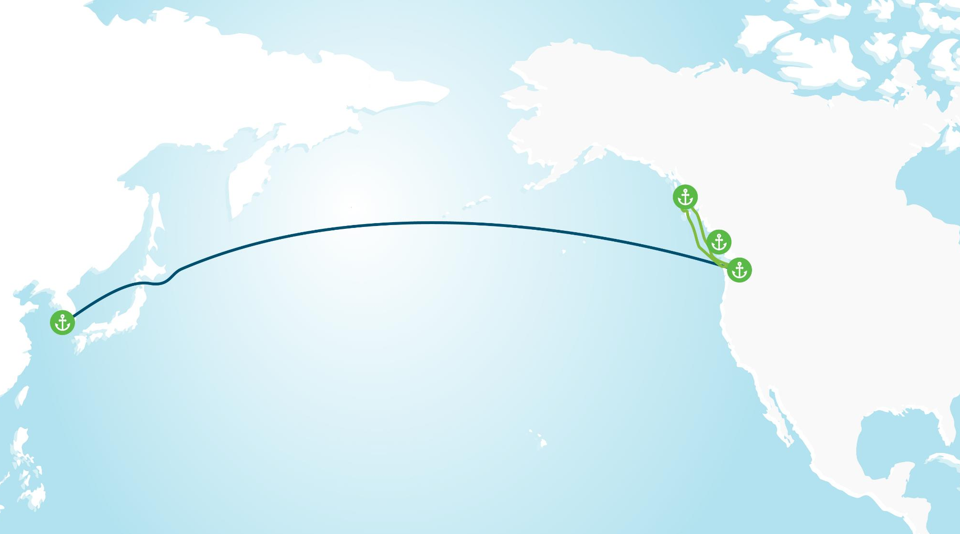
Decarbonizing Maritime: Green Corridors
PACIFIC NORTHWEST
TO ALASKA
ALASKAN AND CANADIAN PORTS
Juneau, Haines, Skagway, Sitka, Vancouver BC, Victoria BC
BUSAN, SOUTH KOREA
SEATTLE AND TACOMA, USA
BUSAN,
S. KOREA
Notes:
But we know that electrification will not work for every industry, and in every application.
Which is one reason the Port of Seattle is involved in two Green Corridor projects – where we are working intensively with industries to explore the feasibility of decarbonizing a several routes.
Our cruise-led Pacific Northwest to Alaska Green Corridor is looking at fuel pathways and strategies for decarbonizing a passenger cruise route.
With the Seaport Alliance we are supporting a cargo-led Green Corridor to Busan South Korea.
Along the way we are learning which fuel pathways and infrastructure will be critical to supporting clean maritime operations...and preparing to apply those lessons to other industries in our harbor.

Slide 11
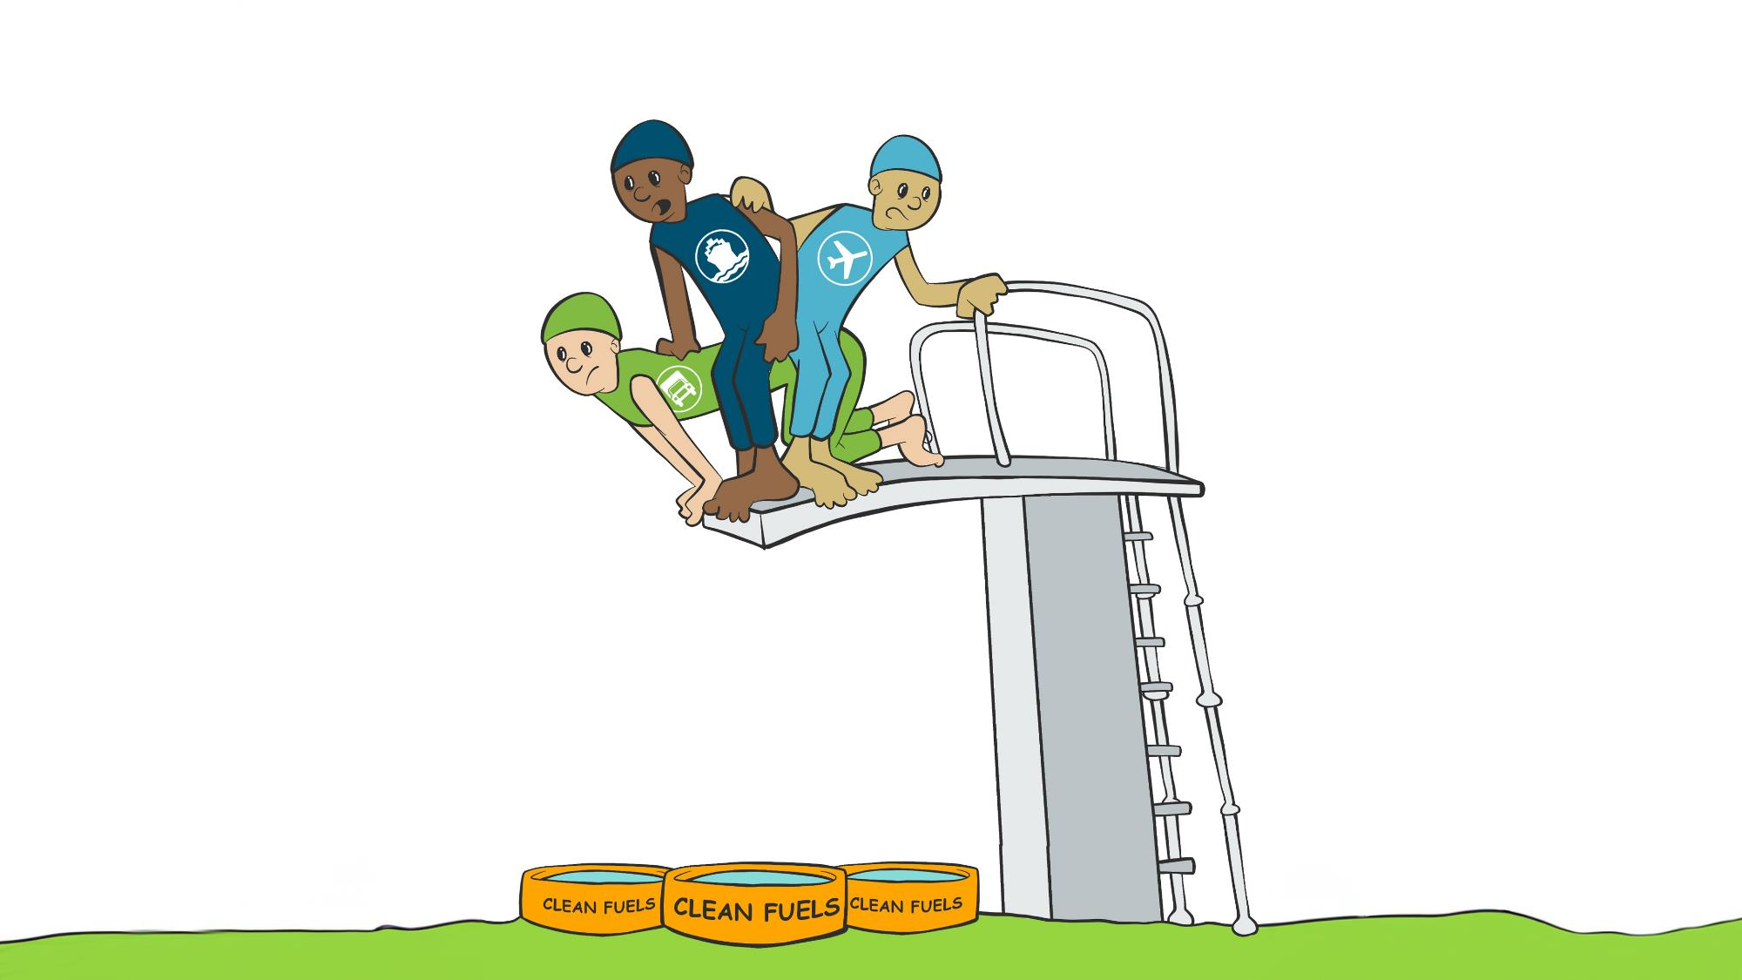
Notes:
So this is a little cartoon we made to illustrate the unique moment we are in right now.
Up on the diving board are some of our Port-related industries…shipping, trucking, and aviation.
And way down below are some tiny pools of clean fuel.
The reality is while we are closer to clean fuels today than we were even just a few years ago…
Across our industries we still have questions about the right fuels for the future…
We do not have the supply we will need …
Solutions like electrification will require more energy than we have available today and are not feasible for every industry.
So it does feel a little bit like we are standing at the edge of the high dive, making a commitment to jump, with less certainty than we want.

Slide 12
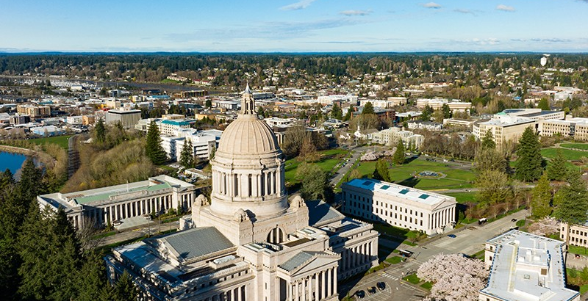
Policy, Grants, Advocacy
Notes:
Which is why the Port places so much emphasis on lining up the incentives, grants, and other advocacy tools that will make that transition easier and faster.
Industry does not have to do this alone.
For example, just last month we received some exciting news that Washington state will receive Department of Energy funding for a new hydrogen hub.
The Port of Seattle supported this hub through a project proposal by the Northwest Seaport Alliance.
We expect that hydrogen will play some role in the future of a decarbonized Port, and our Port was already beginning to explore this future with Seattle City Light and others.
Transitioning to a clean energy economy is one of the greatest challenges of our time.
It’s also a major opportunity for establishing new industries here in Washington to support engineering, manufacturing, logistics, and implementation of low-carbon solutions and efficiency measures for the way you work today.

Slide 13
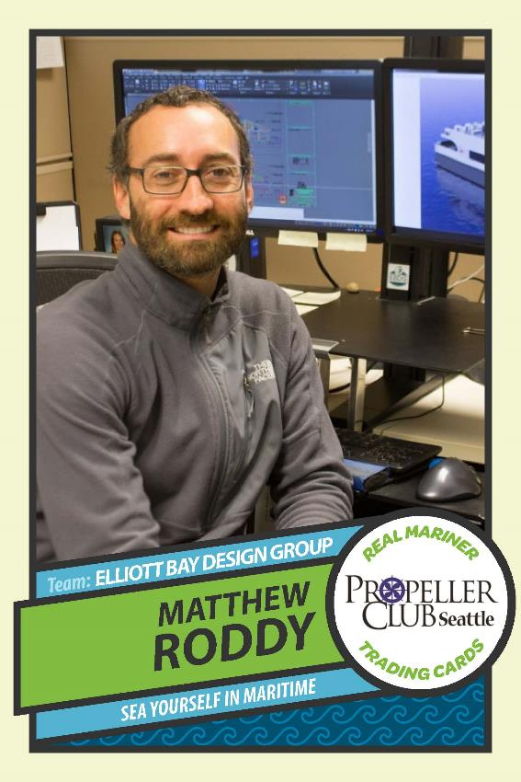
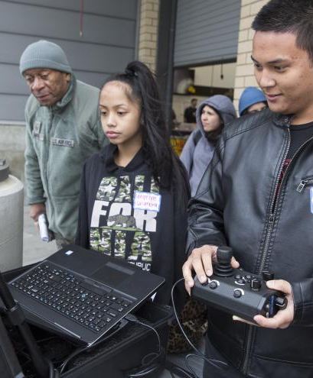
Maritime Works
Job Fairs
Youth Career Launch
Notes:
Getting there requires a trained and motivated workforce, and we are determined to be innovative in our work to recruit new leaders into maritime.
This year we worked with the Propeller Club to create “real mariner” playing cards, which we are using as recruitment flyers at community events.
Right now we have about 25 businesses supporting this campaign, along with the City of Seattle and Washington state ferries.
The Maritime Works campaign has been a huge success this year, thank you to Ken Saunderson and Anne Avery for your leadership on this work.
We obviously need more partners and would like to see more of the industry involved.
Last year we doubled our investment in the Youth Career Launch. We are underway with partnerships through the Urban League and Washington Maritime Blue.
We hosted three roundtables this year with employers to recruit for that program and make it work better for you. Thank you to those who attended…if you did not…please see Andy Gregory – he’s going to make sure you attend the next one!

Slide 14
Thank You!
www.portseattle.org/subscribe
Notes:
Thank you for the opportunity today to be here today.
While the economy keeps throwing us curve balls, we have a century-old strategy for success.
Support our diversified working waterfront with the space and infrastructure you need to succeed.
Create opportunities for all as we work.
Make big bets and build the Port of the future.
This is how we continue to position ourselves in a dynamic global economy.
We are lucky that we have partners across Washington who believe in this vision.
We are so grateful to all of the leaders in this room for prioritizing the maritime, logistics, and trade economy as part of your growth strategy for Seattle.
Thank you!

