Slide 1
Lynden Family of Companies Maritime Economic Forecast Jon Burdick, President & CEO

Slide 3
How it started…
Notes:
1906 Lynden Transfer, horse / iron wheel Ed & Ethel Austin
1926 Horse to horsepower
1948 Growth, HJ

Slide 4
1975 TOTE Seattle–Anchorage service
Notes:
In 1975 TOTE service began and we shifted the highway volumes over to the ship. The beginning of a very successful relationship

Slide 5
LTI, Inc./Milky Way
Liquid and dry bulk commodities
Custom-built equipment
Leading bulk milk hauler in Pacific Northwest
Hauls a variety of products in food grade bulk tankers, temp controlled trailers, and belt trailers

Slide 6
Lynden Transport
Services include:
Full and less-than-full truckload
Van and temperature controlled,
Flatbed
Scheduled services covering all Alaska
Primary industries:
Oil & Gas
Construction
Fresh/frozen goods including seafood
Manufacturing
Retail

Slide 7
Knik Construction
Complex, logistically challenging projects
Civil construction projects include:
Airport/runway
Road
Asphalt paving
Excavation
Dredging and crushing

Slide 8
Lynden Logistics
Air and sea freight forwarder
AK,HI,PR and international
Customs brokerage
Supply chain management
Services range from complex international projects to home deliveries

Slide 9
Lynden Logistics Healthcare
Warehousing and distribution throughout Canada
Inventory and order fulfillment
Specialties include:
Pharmaceutical/healthcare
Health & Beauty
Animal health
Consumer goods

Slide 10
Alaska West Express
Heavy haul truckload provider
Hazardous and non-hazardous chemical and petroleum products
Lynden Oilfield Services, a division of Alaska West Express, provides support for exploration, production, and service companies on the North Slope working to develop Alaska’s oil and gas resources.
Notes:
AWE is Lynden’s Heavy Haul and Bulk Materials carrier.

Slide 11
Lynden Air Cargo
Hercules L382 aircraft operator
Services include:
Scheduled Alaska
Worldwide charters
Disaster relief
Unique takeoff and landing abilities
short field
dirt, ice landing strip capabilities

Slide 12
Alaska Marine Lines
Freight operator, with Western Towboat, in 1980
Scheduled barge services – Seattle to/from:
Southeast Alaska
Central Alaska
Western Alaska, Aleutians, Arctic
Honolulu, Hawaii
Specialized and exclusive equipment
Close relationships with communities serviced

Slide 13
Major ports served

Slide 14
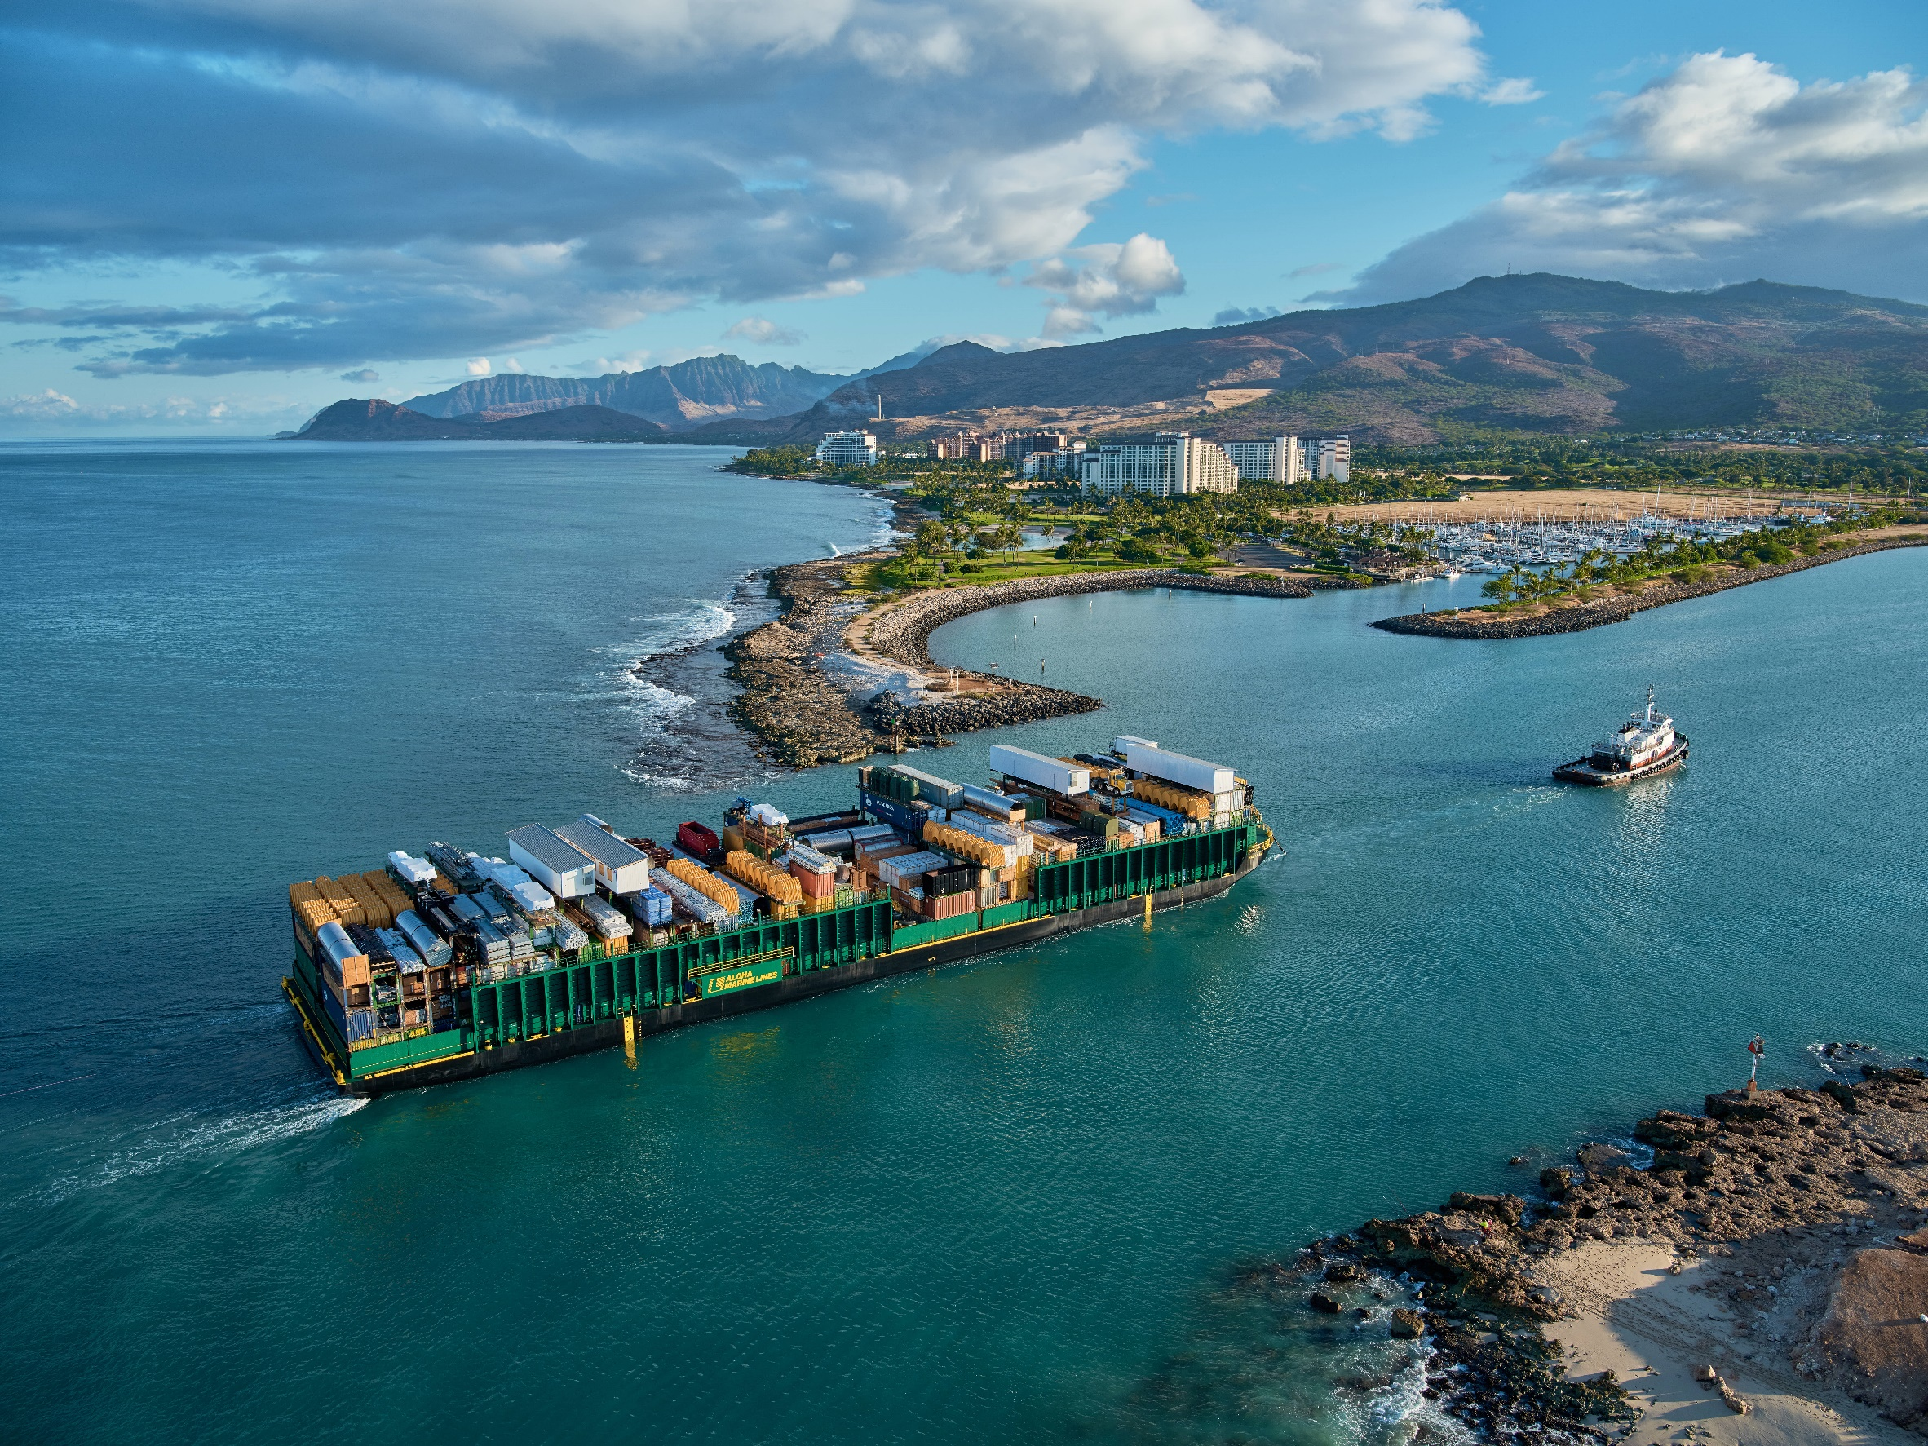
Marine fleet: ~40 tugs/landing craft/barges

Slide 16
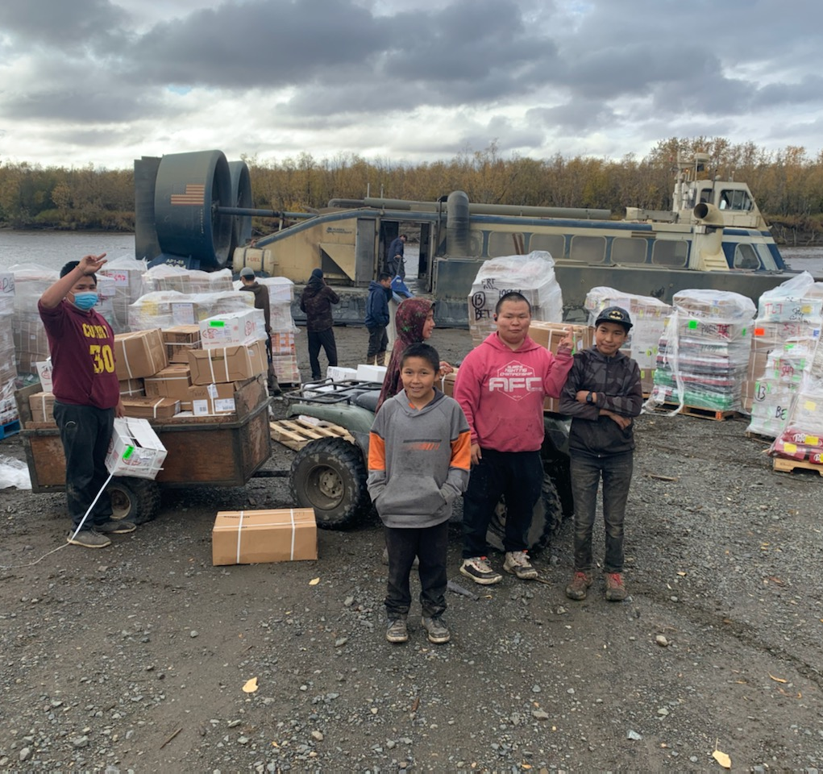
Hovercraft: Kuskokwim river, north slope

Slide 17
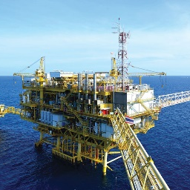
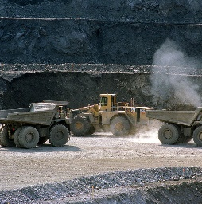
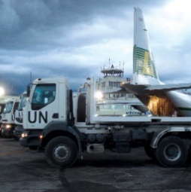
Industries Served
Oil and Gas
Mining
Seafood
Grocery Chill
and Frozen
Dairy
Construction
Automotive &
Marine Parts
Disaster Relief
Retail
Healthcare
Notes:
Like TOTE Lynden serves a wide range of customer verticals.

Slide 18
How it’s going!

Slide 19
Who is Lynden?
Family-owned
A proud history of taking care of its employees, customers and communities
Efficient and Green
Programs to promote a clean environment while maintaining efficiencies
Quality Service, Customer Driven
Knowledgeable, innovative, reliable
Safe Workplace
Great care is taken to ensure we provide a safe, healthy and drug-free workplace
Community Focused
Our employees frequently volunteer, and we support many charities and organizations

Slide 20
Challenges and Opportunities
Skilled labor shortage
U.S. Economy
CARB ZEV
Alaska Project Economy
Technology

Slide 21
Thank You! We appreciate your time today

