Slide 1
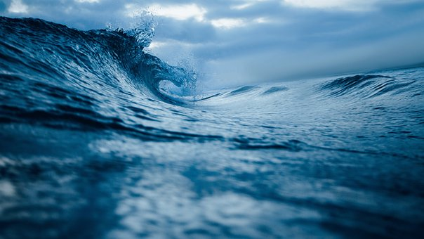
State of INNOVATION
for Maritime, Oceans, and Fisheries

Slide 2
The OECD projects the doubling of the ocean economy from 2010 to 2030, to reach USD 3 trillion and employ 40 million people
Global Value Added in the Ocean Economy
$3
Trillion
$1.5 Trillion
2010
2030

Slide 3
70% of the planet’s surface is ocean, while 90% remains unexplored
Half of the oxygen you breathe comes from the ocean, while acidification and pollutants run rampant
80% of goods are shipped via ocean, while shipping accounts as the 6th largest global emitter of carbon and GHG’s as much as Germany
Significant wind, wave, and tidal renewable energy goes untapped
Fishing stocks decline from ocean climate change and illegal fishing
Sea level rise is swallowing coastal communities around the globe
Significant disproportional access to ocean resources and livelihoods
Meanwhile…

Slide 4
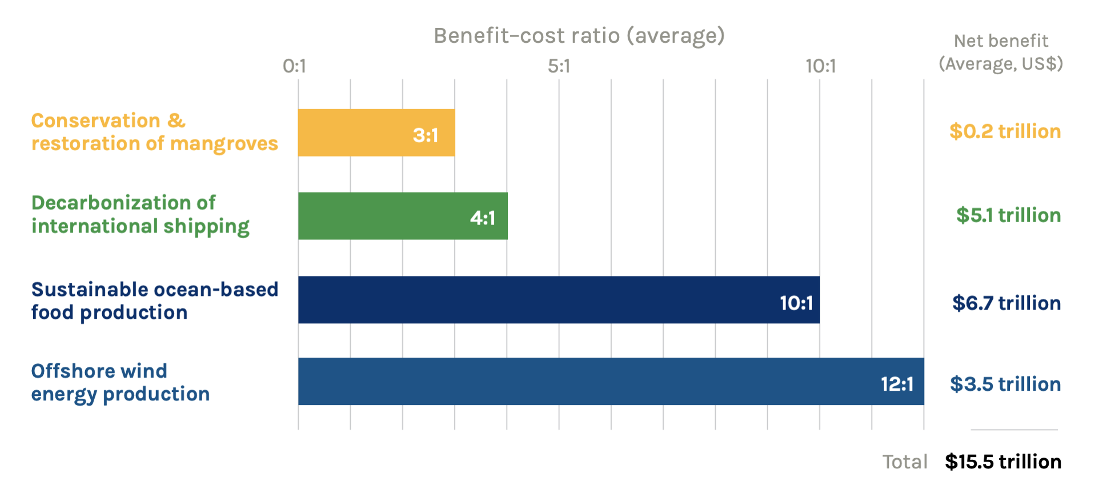

Slide 5
An Innovation Cluster Organization

Slide 6
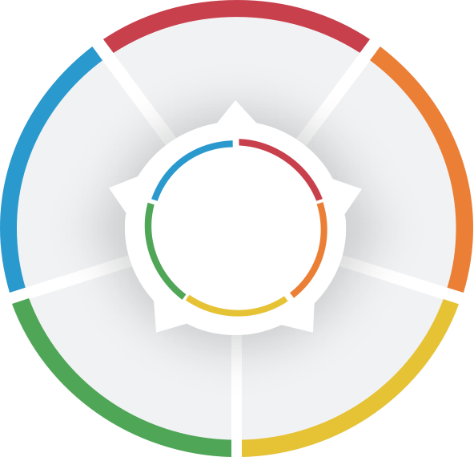
Strategic Focus & Leadership in the Blue Economy
This we KNOW
Ocean based solutions and the Blue Economy are critical for addressing the climate crisis while supporting thriving and equitable communities with significant economic opportunities.
HOW we do it
Ocean/Maritime Innovation Clusters activate and catalyze public/private/philanthropic capacity to accelerate innovation, investment, and community development.
Sustainable Fishing & Seafood
Renewable
Ocean Energy
Renewable
Ocean Energy
Healthy Ocean Ecosystems
Justice, Equity, Diversity & Inclusion
Maritime Decarbonization
Digital Transformation
Notes:
Learned about the effectiveness of Cluster Organizations –each unique – but all around the idea of Triple or Quadruple Helix,. Govt – Industry – R&D and in our case, community organizations

Slide 7
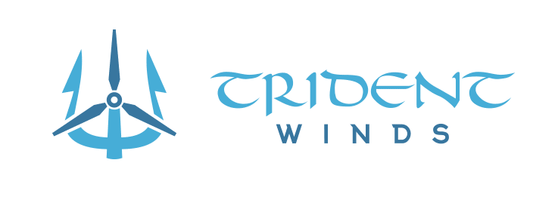
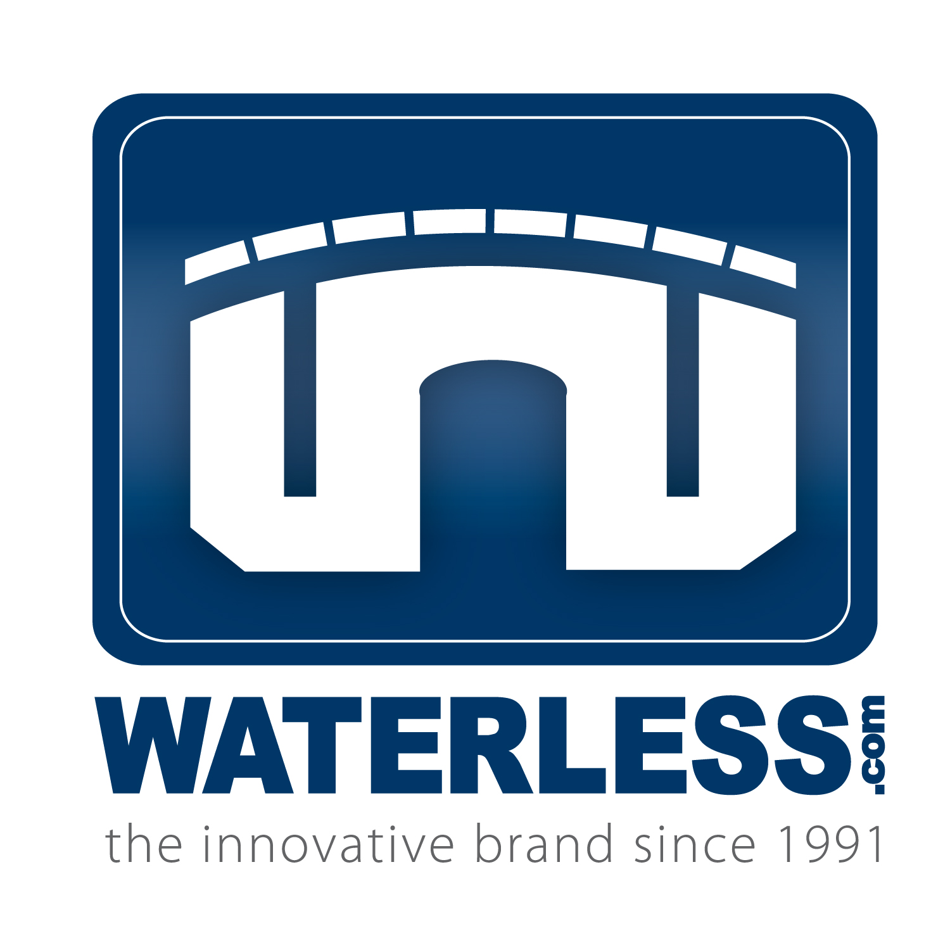
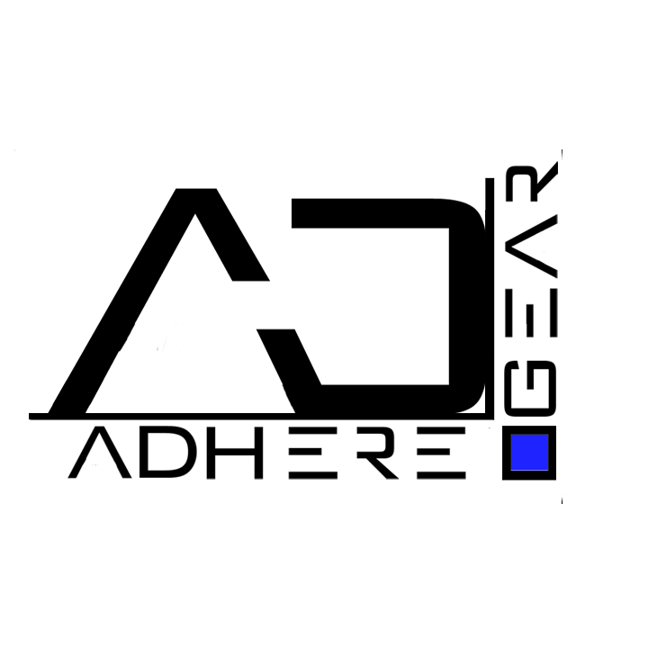
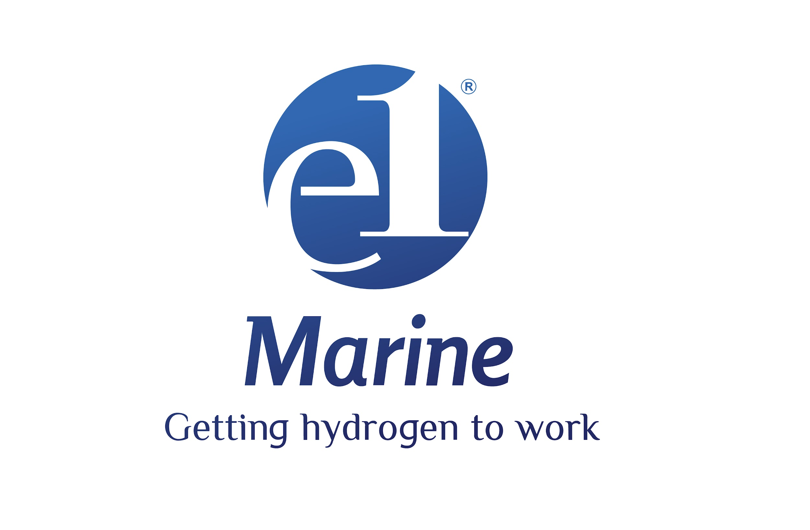
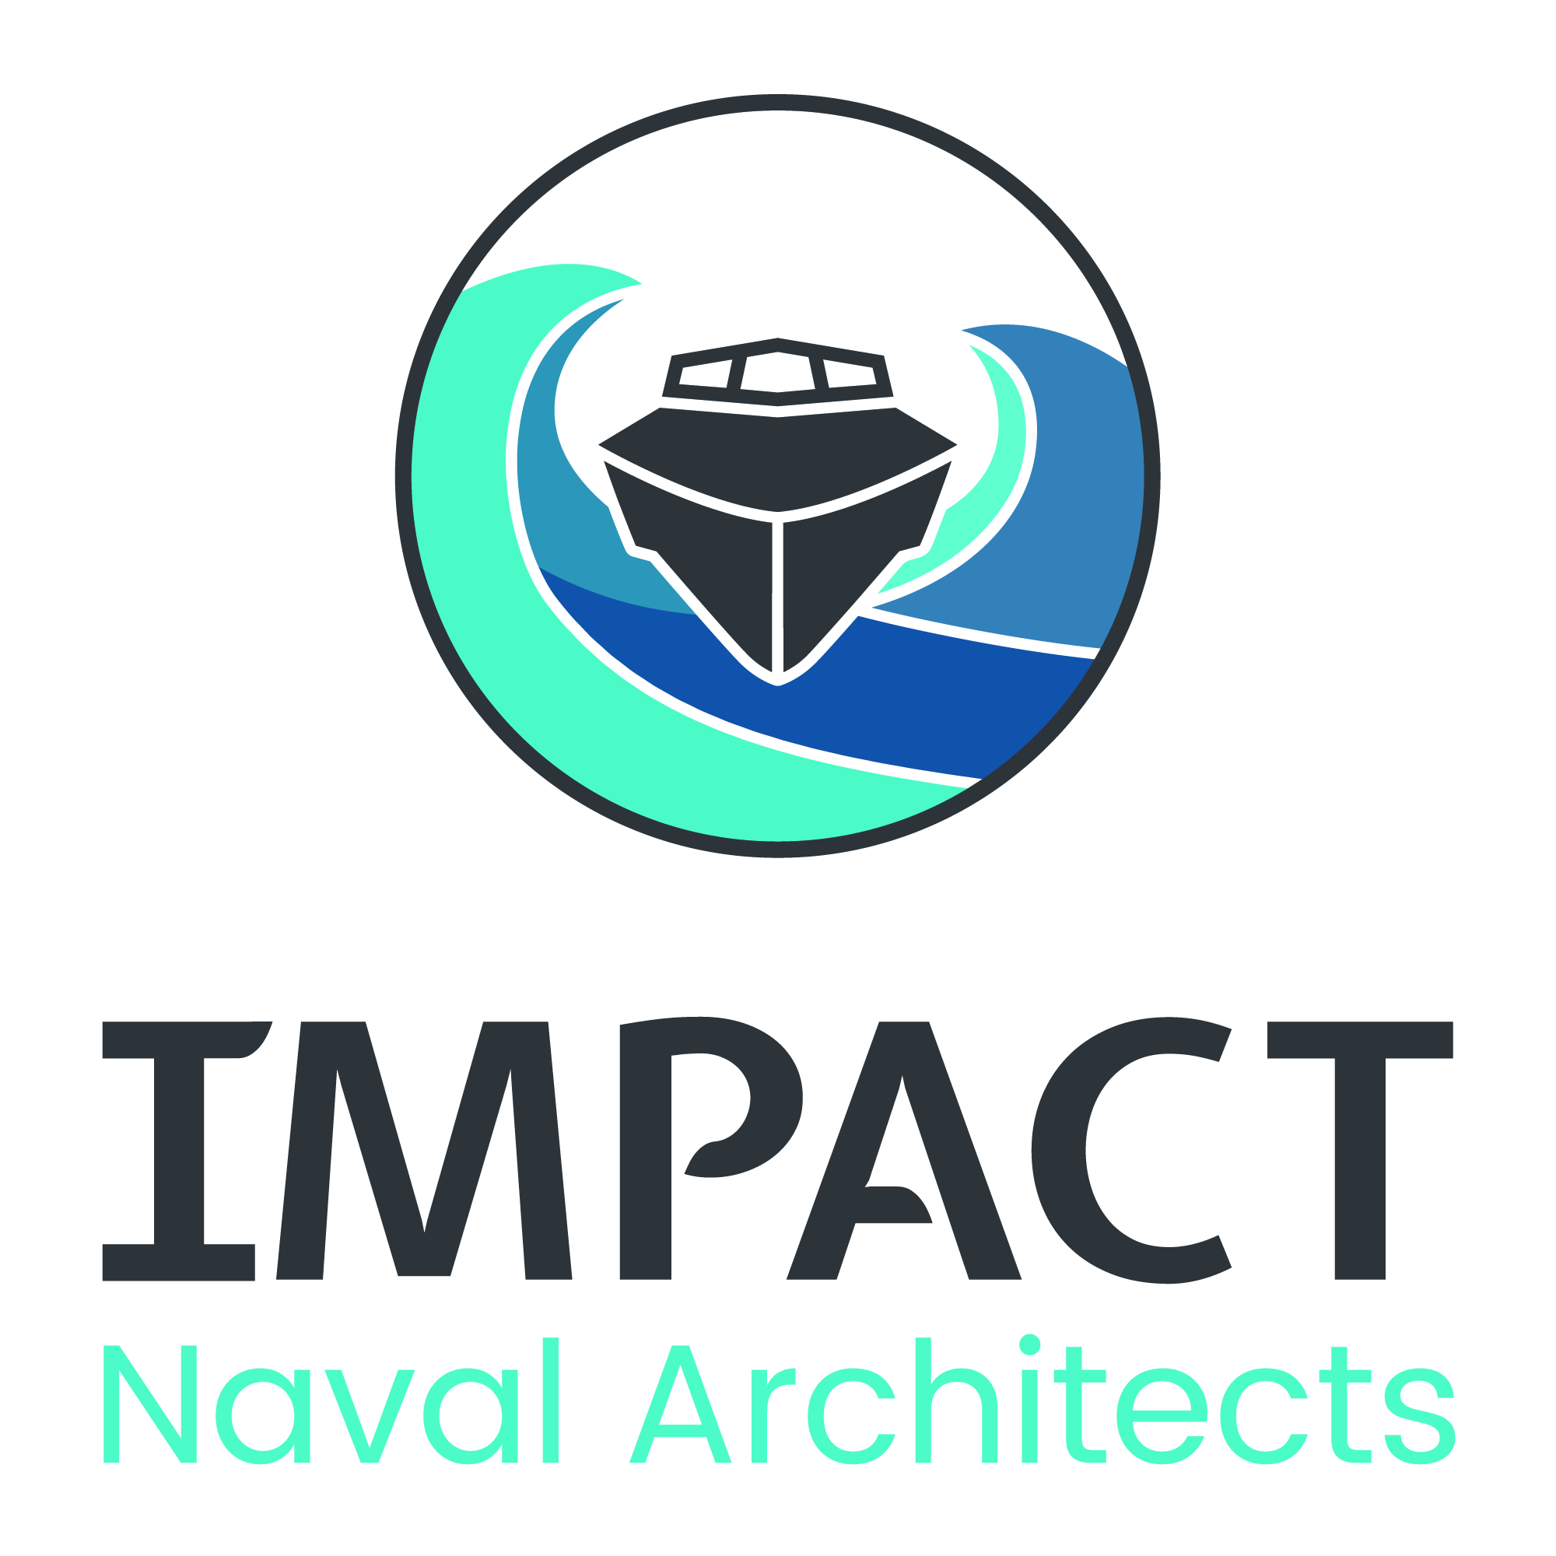
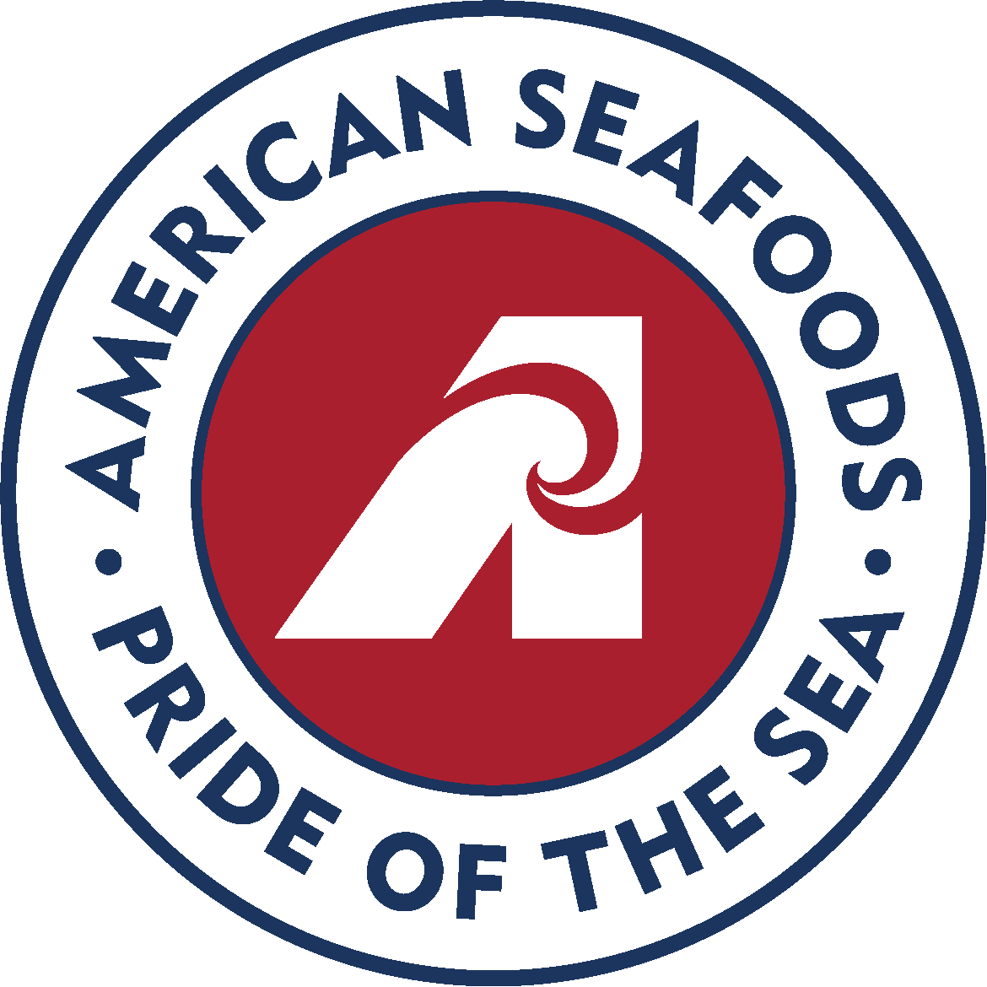
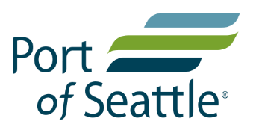
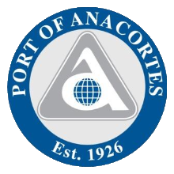
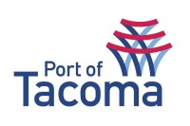
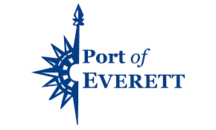
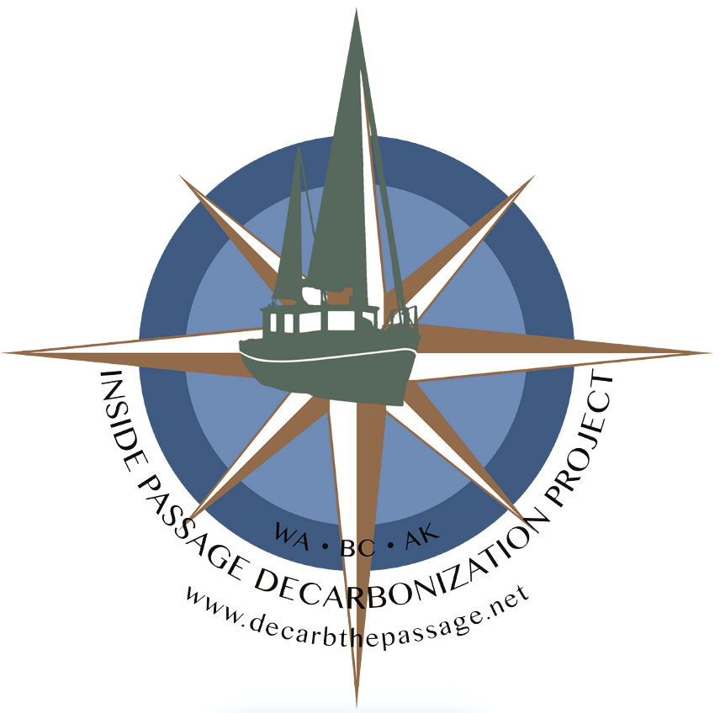
Industry Members
HULL SCRUBBER
Community Partners
Research Institutions
Public Partners
Notes:
We have gained significant traction, engagement and investment – 120 members from national research labs to agencies to global technology providers, startups to community based workforce programs

Slide 8
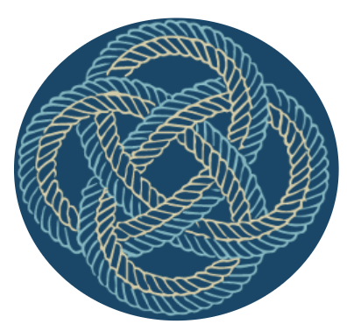
Impactful Programs to Accelerate the Blue Economy
Blue Ventures
Supporting Entrepreneurship and Capital Investment for Ocean-based Solutions
Joint Innovation
Collaborative Initiatives and Project Management for Innovation and Development
Equity Engagement
Career Connected Workforce and Employer Development through an Equity Lens
Blue Hub
Home for Facilitation, Convening, Collaboration & Knowledge Sharing
Notes:
Describe briefly the scope of work – 6 F’s
Maritime Blue engages members, partners and stakeholders in a number of ways in order to fulfill its mission. Taking lessons learned and models from other cluster organizations and innovation ecosystem builders around the globe.

Slide 9
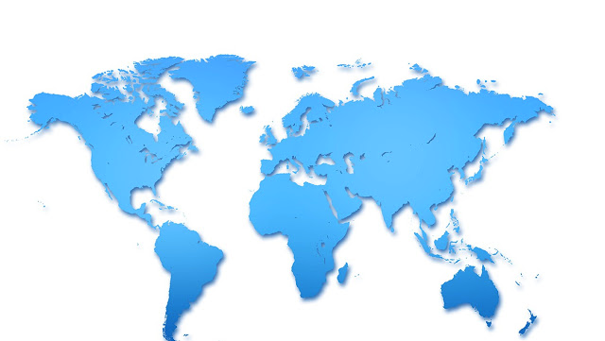
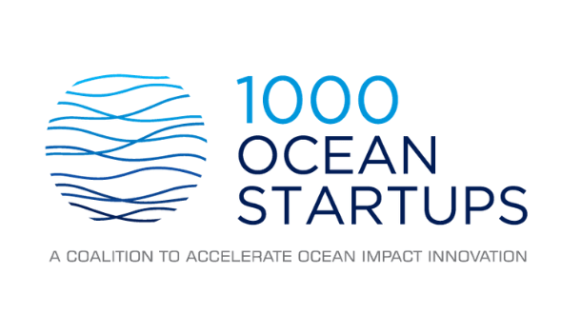
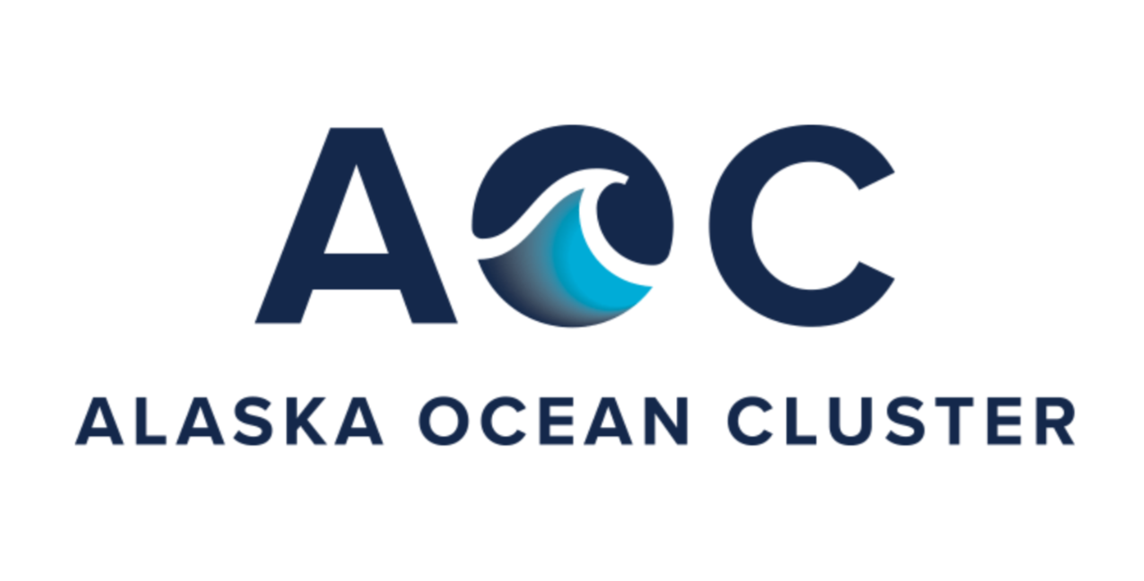
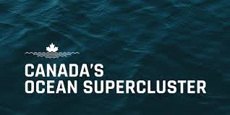
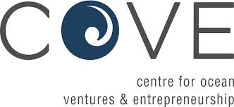
Part of a Global Enterprise for the Blue Economy

Slide 10
Fostering an
equitable and diverse 21st century workforce through career connected learning and employer driven engagement
Equity Engagement
The Carrick Bend Knot
Its purpose is to connect two lines of different type and size. It’s particularly appropriate for very heavy rope or cable that is too large and stiff to be easily formed into other common bends. It will not jam even after carrying a significant load.
Notes:
Intro : Robert + LeAsia

Slide 11
We champion diversity, equity and inclusion through continuous operational and interpersonal mindset change and recognizing the important intersection of environment, sustainability and racial equity.
Impact
2020-2023
Total Interns Served: 72
Total Stipends Earned: $145,000
Total Career Awareness Events: 34
Total Youth Served: 358
Total Employer DEI Training: 31
Race/Ethnicity Demographics of Youth Served:
African-American 23.3%, Hispanic/Latino
42.1%, Asian 28.5%, Caucasian 6.1%
Notes:
Robert

Slide 12
Joint Innovation
Members come together through Strategic Initiatives & Joint Innovation Projects (JIPs) to collaborate and implement key demonstration projects to accelerate Ocean health and the Blue Economy
Notes:
Examples of work underway

Slide 13
Joint Innovation Continuum
Strategic Initiatives & Collaboratives
Market Identification
Technology Development & Feasibility Studies
Demonstration Projects
Technology Adoption & Commercialization
Joint Innovation Projects
Notes:
Convene around early stage markets
Collaborate around early stage demonstrations
share resources
stack funding
de-risk

Slide 14
Collaborations and Strategic Initiatives
A Voluntary Program to Reduce the impacts to Southern Resident Killer Whales from large commercial vessels.
A Collaborative Approach to Equitable Benefits from Floating Offshore Wind Supply Chain Development.
Facilitating Port and Maritime Advisory Input for the Pacific Northwest Hydrogen Hub Development.
Green Shipping Corridors
Supporting the Development of Green Shipping Corridors in the Pacific Northwest.
Notes:
Quiet Sound - as a model for how to shape some of this work that we might lead
Blue Wind: funding from Climate Solutions, planning committee, announced initiative with support from Gov Inslee - formalize leadership committee, set priority working groups
H2 Hub - awarded!!
Green Corridors- more updates in the next couple of months with COP
Sustainable Maritime Fuels

Slide 15
Studies & Analysis
Safety Study for Decarbonization of Fishing
Sustainable Maritime Fuels Roadmap
Tacoma Tideflats 5G Use Case & Feasability Study
Maritime Electrification for Utilities

Slide 16
Joint Innovation Projects
Zero-Emission Foil Fast Ferry: from Concept to Demonstration
Tacoma Blue EDGE Network & 5G Port Innovation Lab
Green Hydrogen Shore Power: Formic Acid as a Liquid H2 Carrier
Notes:
Foil Ferry - Recently released PDR, final report soon to follow
5G - secured funding for first deployment, installation complete in November
Tacoma Green Hydrogen - secured funding for scale up, first LHC project in late 2024 in Tacoma

Slide 17
Blue Ventures
Supporting entrepreneurs and startups in maritime, ocean, and related sectors building the Blue Economy

Slide 18
Growing Pipeline of Blue Startups Globally

Slide 19
Growing Capital Investments

Slide 20
Growing Global Ecosystem

Slide 21
Our growing innovation programs work to support founders and startups at every stage of their journey.
Our Blue Ventures Programs
Blue Innovation Accelerator
One Ocean
Accelerator
Tacoma & Seattle Incubators
4 Month Mentor-based Innovation Accelerator
12 week program for International startups for WA/US market entry
One Year Incubators
in Tacoma & Seattle

Slide 22
Our Programs have IMPACT
56 Startups Engaged since Jan 2020
Wins and Deals
$400M + in Capital Investments
3 Exits (1 pending)
Several Demos & Customer Acquisitions
Over %500 increase in revenue
At least 400 jobs created
Cluster Engagement
Startups receive year-long membership with Maritime Blue and continue engagement with Cluster partners and the sector.
Demographics
Local - 65% PNW // 35% other
Gender - 70% male // 30% female or NB
Race/Ethnicity - 64% white // 36% BIPOC
Identify as Underrepresented - 46%

Slide 23
Our time to LEAD!
 | Location | Accelerator | Incubator | Cluster | Industry Partners | Mentors | Invest | VC Mindset | Hub | SDG Goals | Other
Maritime Blue | Seattle | ✓ | ✓ | ✓ | ✓ | ✓ | 2024 | ✓ | 2025 | 8,9,13, 14 | GNW Focus, Global Reach
Braid Theory | Los Angeles | ✓ | ✓ | ✓ | ✓ | ✓ | X | X | X | 14 | Science only
Alta Sea | Los Angeles | X | ✓ | X | ✓ | X | X | X | 2025 | 9,13,14 | Science focus
Scripps | San Diego | ✓ | X | X | X | X | X | X | X | 14 | Scripps focus
TMA | San Diego | X | X | X | ✓ | X | X | X | X | 9 | Industry focus
Sea Ahead | Boston | X | ✓ | X | X | X | ✓ | ✓ | X | 14 | East US Leader
Woods Hole | Boston | ✓ | X | X | X | X | X | ✓ | X | 14 | $100m Propeller Fund
Katapult | Oslo | ✓ | X | ✓ | ✓ | ✓ | ✓ | ✓ | X | 14 | Oceans only
Pier 71 | Singapore | ✓ | X | X | ✓ | ✓ | ✓ | ✓ | X | 8,9 | Shipping only
PortXL | Rotterdam | ✓ | X | ✓ | ✓ | ✓ | ✓ | X | ✓ | 8,9 | Shipping only
Bluetech | Lisbon | ✓ | X | ✓ | ✓ | ✓ | X | X | X | 8,9 | Port focus
The Cove | Halifax | X | ✓ | X | ✓ | ✓ | X | X | ✓ | 9,13,14 | Partner w/CDL
Notes:
Learned about the effectiveness of Cluster Organizations –each unique – but all around the idea of Triple or Quadruple Helix,. Govt – Industry – R&D and in our case, community organizations

Slide 24
Blue Innovation Fund
Raising an early-stage investment fund to build on the world-class cluster and programs that exist here in Washington and the Greater NW.
Brock Mansfield
Managing Partner
Blue Innovation Fund
Clean Oceans & Climate Solutions
Maritime Transformation
Sustainable Fisheries
Fund Size: $30,000,000
2024-2027 Deployment Period
Sourcing innovation globally / Accelerating in Seattle
Jean-Noel Poirier
Managing Partner
Blue Innovation Fund

Slide 25
BLUE HUB
The home of Maritime Blue with collaborative work and meeting space for members, partners, and stakeholders

Slide 26
Member Access to:
Events and Convenings
Board and small meeting rooms
Collaborative work space
Drop-in Executive office space
Notes:
Elliot Bay Design group is replacing DHMD in February

Slide 27
Maritime Innovation Center
Under Design and Construction - opening 2025

Slide 28
We seek to co-create a workplace culture and community that aligns with the values of the Blue Economy: diversity, equity, inclusion, and health.
Rachel Aronson
Director, Quiet Sound
Joshua Berger
President/CEO
Robert Brown III
Program Manager,
Equity Engagement
Cassidy Fisher
Director,
Joint Innovation
Veasna Hoy
Director,
Equity Engagement
LeAsia Johnson
Manager, Youth Programs
Karina Martija-Harris
Manager, Tacoma
Maritime Incubator
Caitlin O’Morchoe
Sr. Manager, Quiet Sound
Jean-Noel Poirier
Executive in Residence
Daniel Pulse
CFO (Interim)
Camille Smith
Contract & Finance Manager
Devon Thorsell
VP of Operations
Sara Adams
Graduate Fellow

Slide 29
Local Contracts
Leading Members
Time to Lead
Join Us!
Federal Contracts
Foundation Grants
Project Sponsors

Slide 30
HAPPY HOUR
RECEPTION
Thursday, Nov 9th, 4-7pm
&
Meet up with the
Blue Ventures Ecosystem
Check out the latest in
All-Electric Outboard Propulsion
RSVP Here
tinyurl.com/2f4777fy
Interested in a Demo Sea Trial?
charles@photonmarine.com | 971-404-5632
542 1st Ave S Suite 300 - Just blocks away from
Notes:
Tags
1000 oceanstartups
World economic forum
Builders vision
Investable oceans
Meliorate partners

Slide 31
THANK YOU!

