Slide 1
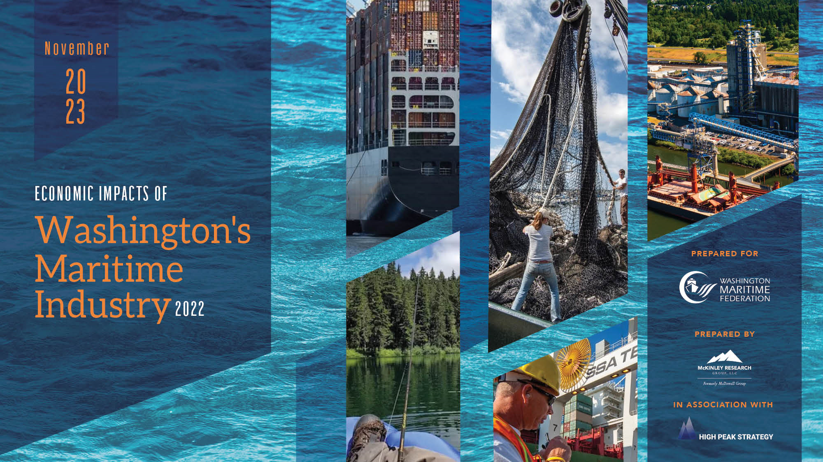
PME Economic Forecast Breakfast
November 9, 2023
Prepared for
Prepared by
Prepared by
In association with

Slide 2
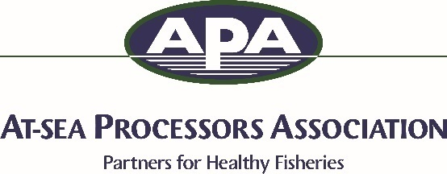
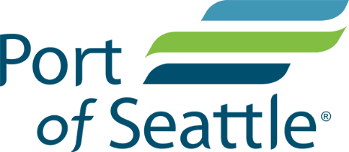
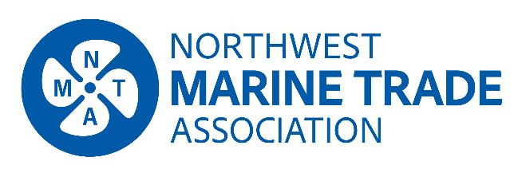
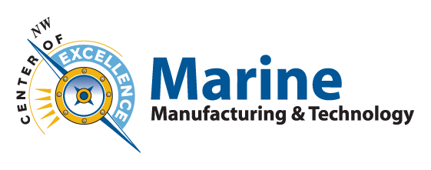
Study Sponsors
Bronze Sponsors
Gold Sponsor
Silver Sponsors
Notes:
in

Slide 3
Methodology
Data Sources
U.S. Bureau of Labor Statistics, ESD, DOR, ADF&G, WSDF&W, NOAA, Census
Industry Sources
WMF board members, seafood companies, workforce development programs, industry associations, ports, maritime support firms
Study Year
2022 had unique challenges: supply chain issues, labor negotiations, geopolitical factors, continued recovery from COVID.
Comparison with 2017 report (referring to 2015 data)
Methodology updated for three out of six subsectors: commercial fishing/seafood, recreational boating, maritime support

Slide 4
Maritime Sectors
Maritime Logistics and Shipping
Shipbuilding, Repair, and Maintenance
Commercial Fishing and Seafood Production
Recreational Boating
Passenger Water Transportation
Maritime Support Services

Slide 5
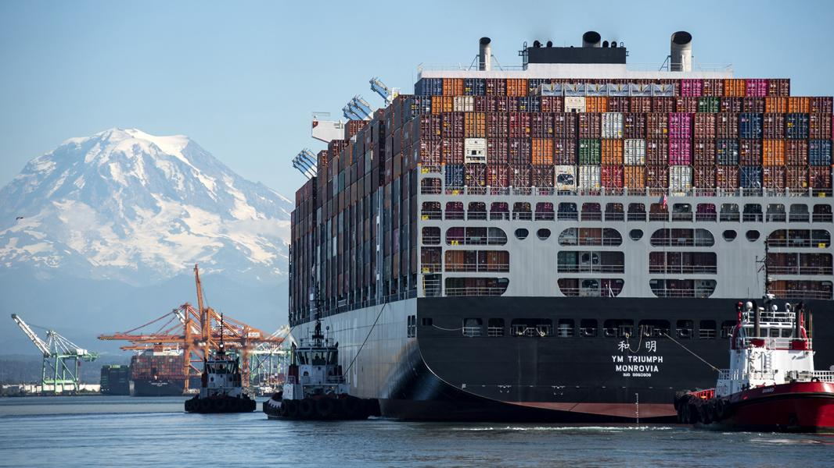
Maritime Logistics and Shipping
Freight transportation, port and harbor operations, tugs/pilotage, cargo handling, warehousing/storage, trucking, rail
11 deep-draft sea and river ports
Northwest Seaport Alliance: 4th largest container gateway in North America
16 billion tons of containerized cargo
56 billion tons of non-containerized cargo
Source: Port of Seattle.

Slide 6
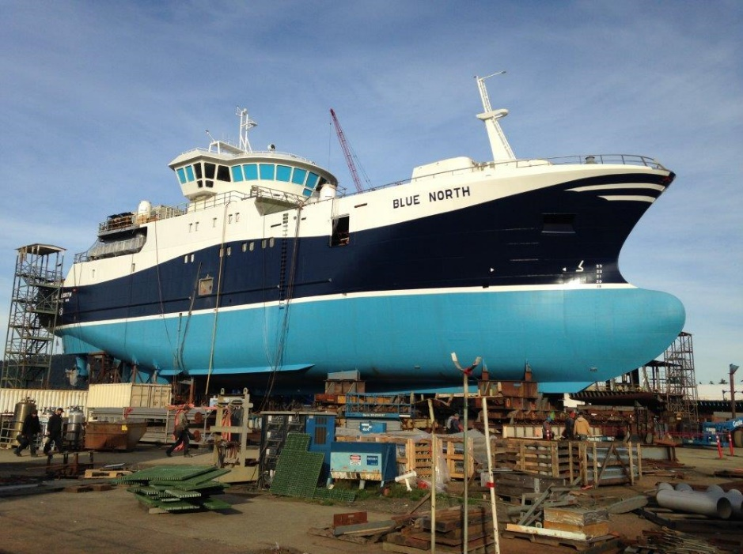
Shipbuilding, Repair, and Maintenance
Commercial, recreational, government
61 commercial shipyards/boatyards
Puget Sound Naval Shipyard: 14,000 workers
2022 exports: $91 million
2022 US DOD contracts: $377 million
Shipyard/boatyard communities: Seattle, Tacoma, Everett, Port Angeles, Anacortes, Bremerton, Bellingham, Vancouver, La Conner, Colville, Clarkston, Port Townsend
Source: Dakota Creek Industries

Slide 7
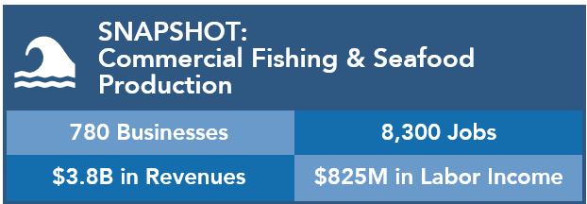
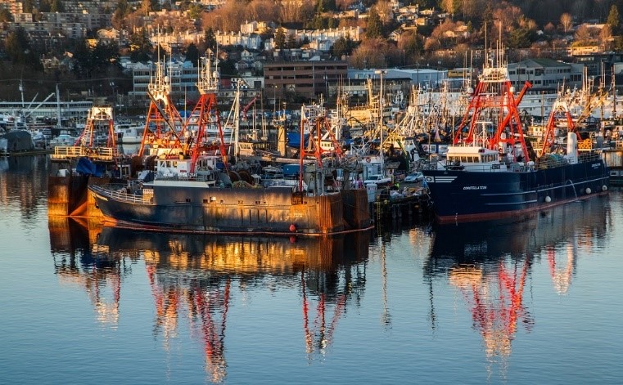
Commercial Fishing and Seafood Production
Fishermen, crew members, aquaculture workers, processor workers (onboard and shoreside)
More than half of employment in seafood production preparation and packaging
More than half of North Pacific fishing fleet homeport in Washington State (>58’)
$1.5 billion in seafood exported from Seattle customs district
Source: Port of Seattle.

Slide 8
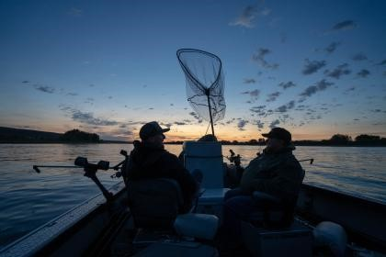
Recreational Boating
Sportfishing, charter fishing, yachting, sightseeing cruises, etc.
Boat purchases, maintenance, equipment, licenses, fuel, provisions
$6 billion: Value of recreational fleet
$456 million: Upkeep and maintenance
1.3 million: Sportfishing licenses sold
Source: Washington State Department of Fish & Wildlife.

Slide 9
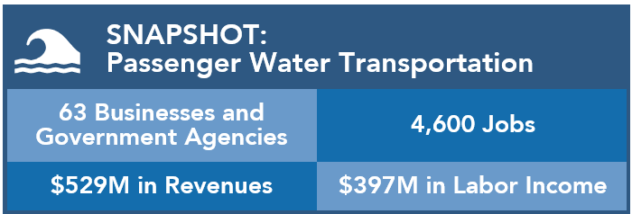
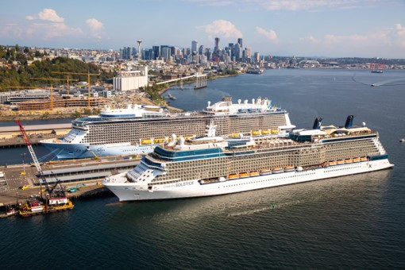
Passenger Water Transportation
Ferries, cruise ships, riverboats
Washington State Ferries: Nation’s largest ferry system
17 million: Number of WSF passengers, 2022
Port of Seattle: gateway for ~40% of Alaska cruise passengers
1.3 million: Number of Port of Seattle cruise passengers, 2022
74%: Increase in cruise passengers, 2014-2023
Source: Port of Seattle.

Slide 10
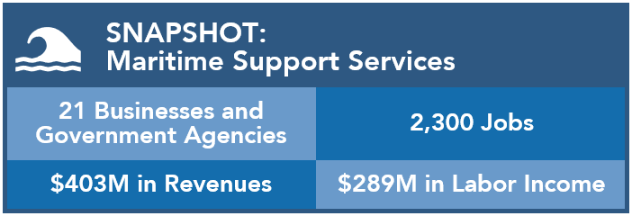
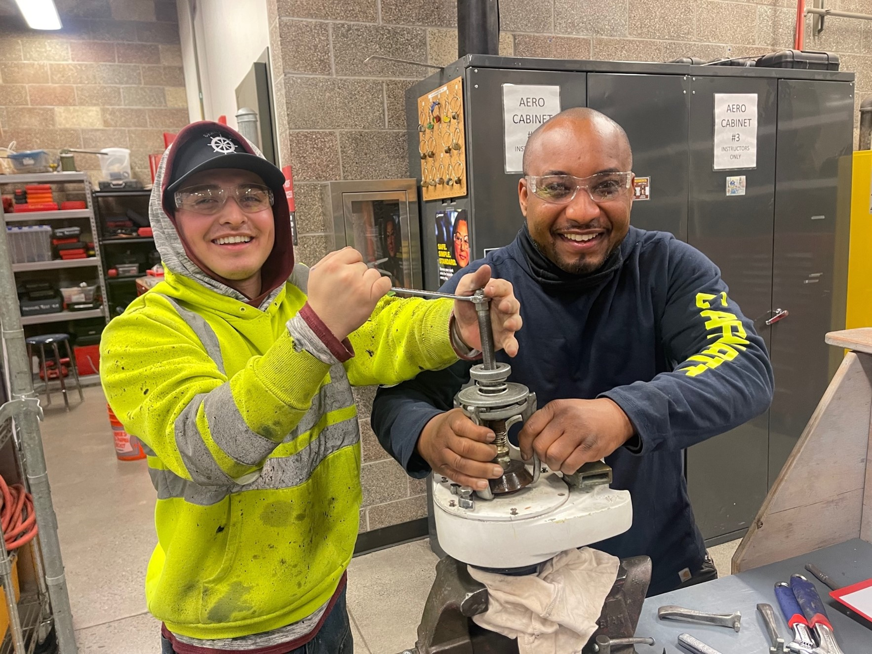
Maritime Support Services
Law, insurance, accounting, construction, naval architecture, educational institutions, research, public agencies, non-profits
Source: Skagit Valley College.

Slide 11
Direct Impacts by Sector
Direct Labor Income, by Sector
($Millions)
Direct Employment, by Sector
Total Direct Employment: 61,900 jobs
Total Direct Employment: $7.0 billion

Slide 12
Total Economic Impacts, 2022
Total Employment
174,300 jobs
Total Labor Income
$14.4 billion
Total Revenues
$45.9 billion
State Government Revenues:
$382 million including direct and indirect impacts

Slide 13
Maritime Employment by County
Sources: U.S. Bureau of Labor Statistics, Quarterly Census of Employment and Wages, 2023; Washington State Employment Security Department, 2023; State of Alaska Department of Fish and Game, 2023.

Slide 14
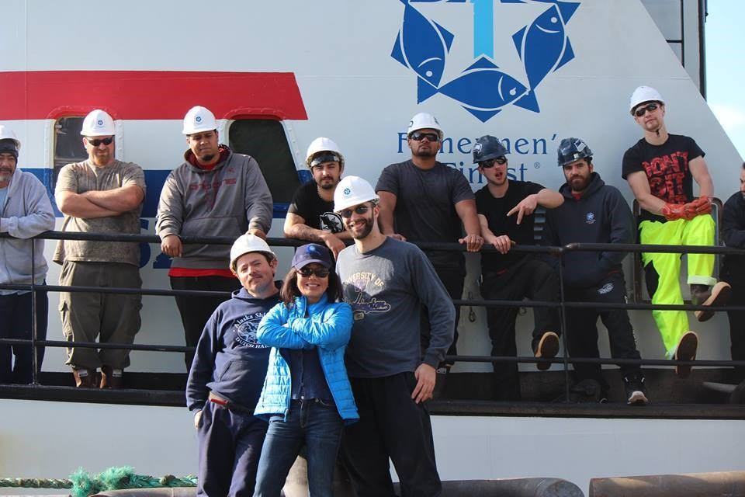
Washington Maritime Worker Earnings
Average Earnings, 2022 (including benefits)
Source: Port of Seattle.
Sources: U.S. Bureau of Labor Statistics, 2023; U.S. Bureau of Economic Analysis, 2023.

Slide 15
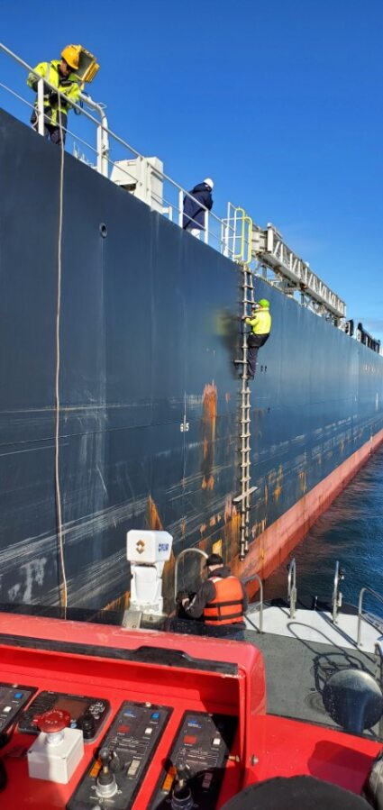
Washington Maritime Industry Occupations
Most Common Maritime Industry Occupations, 2022 (1,000+ workers)
Source: Puget Sound Pilots.
Sources: Washington State Employment Security Department, 2023; U.S. Bureau of Labor Statistics, 2023.
Notes:
Need pic

Slide 16
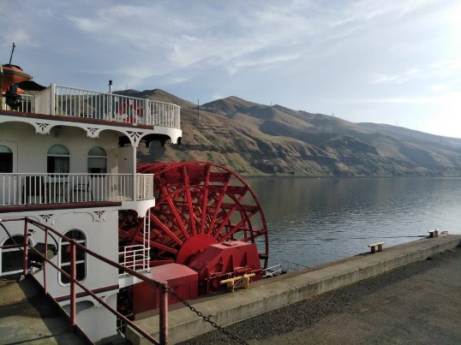
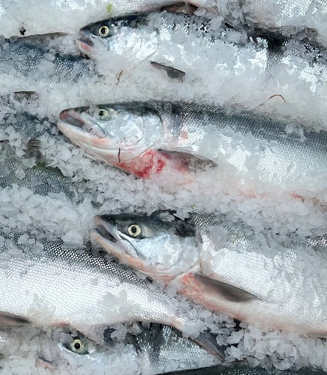
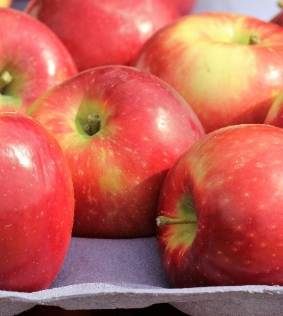
Telling the Maritime Story
The Columbia-Snake River System
The Alaska Seafood Connection
Agricultural Ties
Maritime Innovation
Workforce Development
Environmental Stewardship

Slide 17
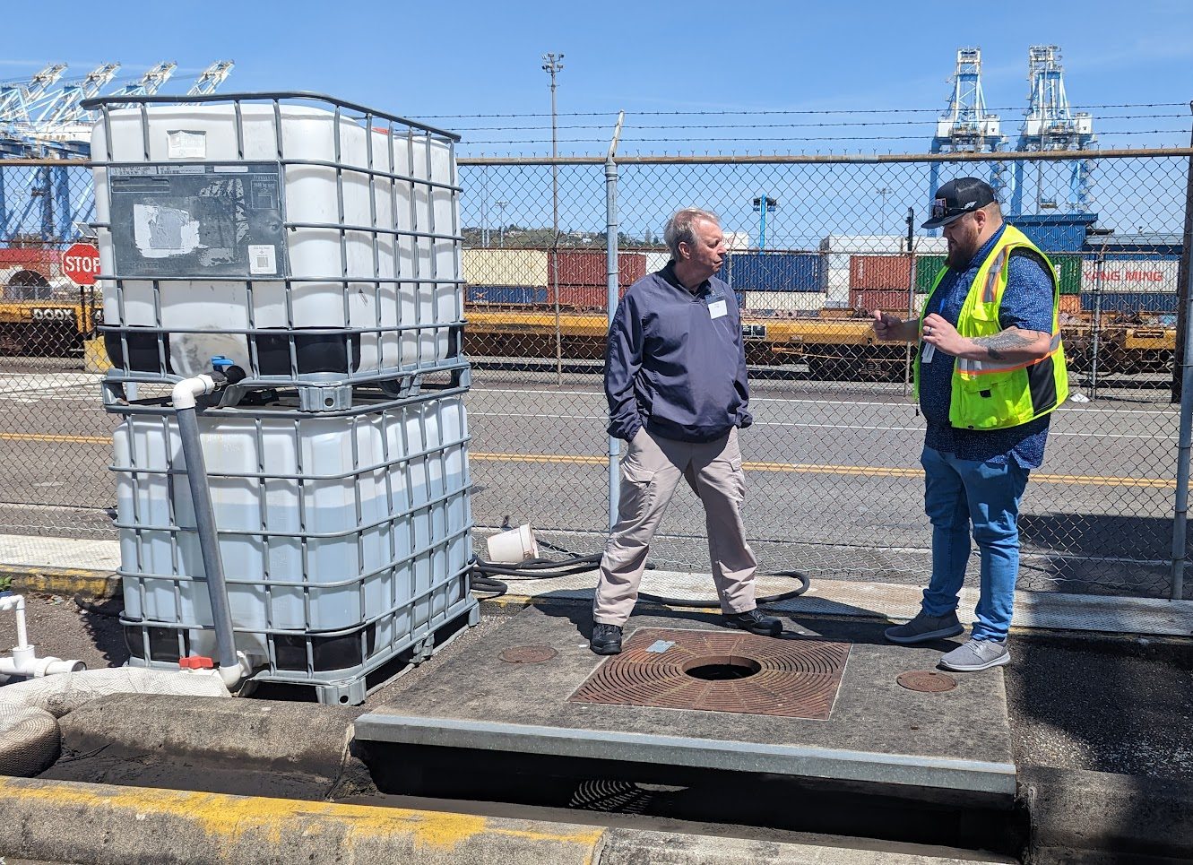
Environmental Stewardship
New ship designs improve fuel efficiency
Better voyage planning
Cleaner engines; alternative fuels
Ballast water treatment improvements
Safer routing distances
Reduced noise impacts
Fishing: vessel and gear innovations, recycling used fishing gear
Cruise: “Maritime Green Corridor”; shore power at Port of Seattle
Green Marine: 10x increase in membership
Source: Green Marine.

Slide 18
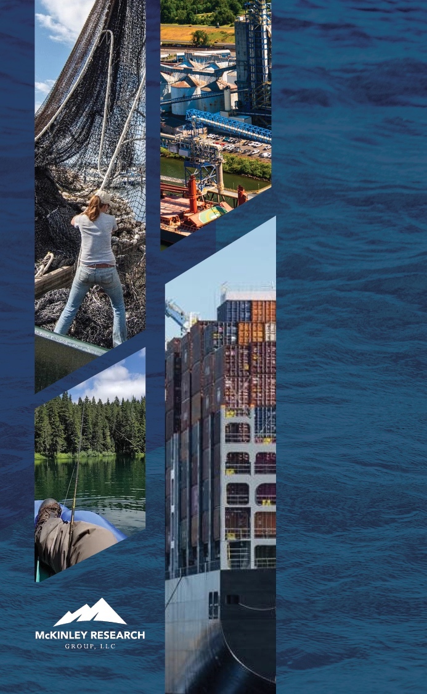
Resources
Report and handout:
www.maritimefederation.com
Presentation/questions:
Heather Haugland
hhaugland@mckinleyresearch.com
Spencer Cohen
spencer@highpeakstrategy.com

Slide 19
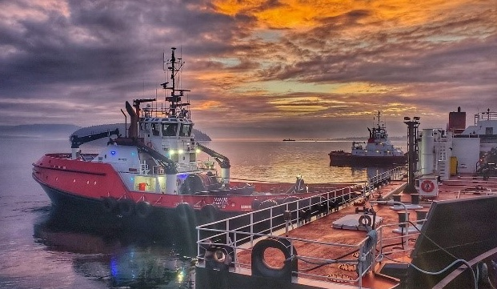
Thank you!

